Slide 1



Taiwo's Project
View in Power BI
Last data refresh:
5/29/2020 10:27:59 AM UTC
Downloaded at:
5/29/2020 10:31:36 AM UTC

Slide 2
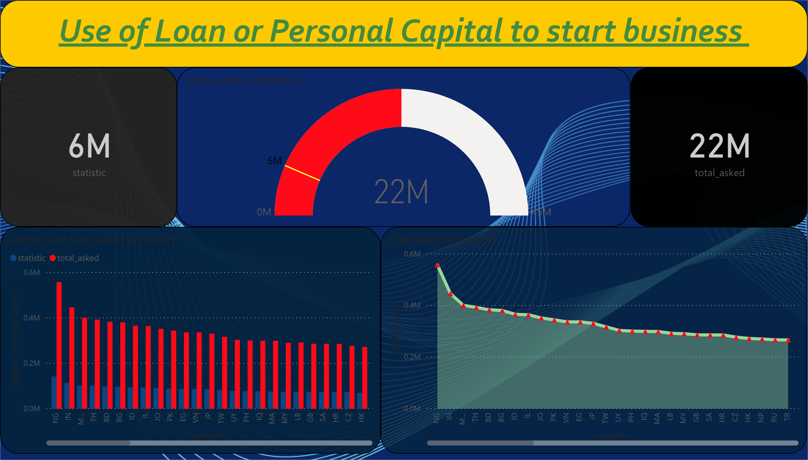

Slide 3
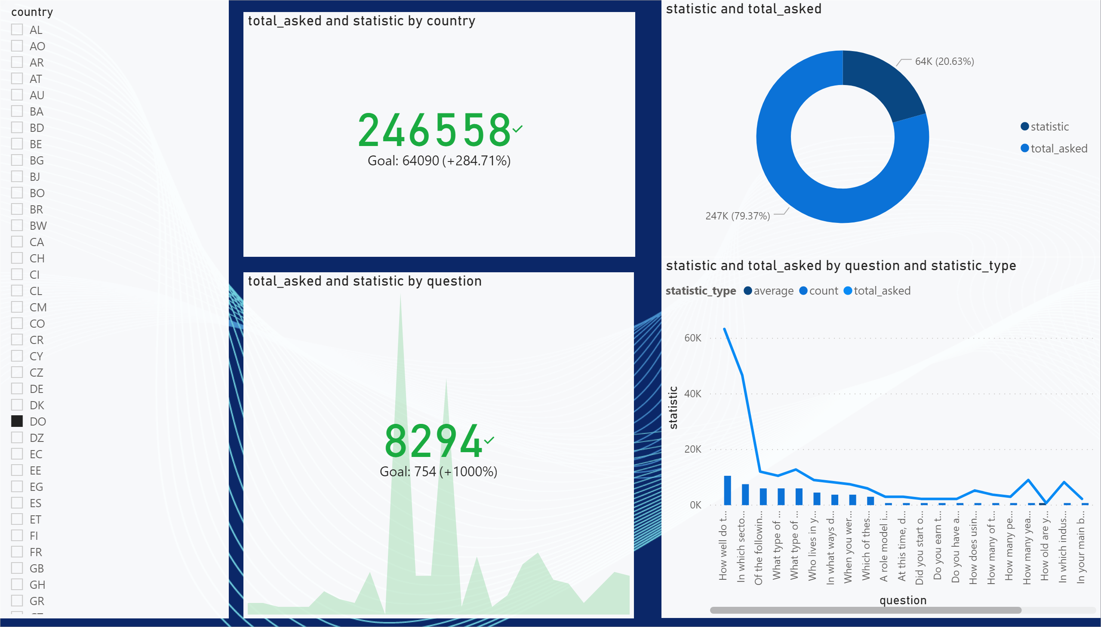

Slide 4
